Slide 1
XGBoost Classification Analysis of Comorbidities for Predicting Mortality from COVID
Capstone Presentation
Western Governors University
Master of Science in Data Analytics
J. Amanda Terzin
November 26, 2022

Slide 2
About Me
Graduate student WGU Master of Science in Data Analytics
Physician assistant with 26 years of clinical experience
- 15 years in Cardiothoracic and Vascular Surgery
- 11 years in Emergency Medicine

Slide 3
Problem Overview
The recent Covid-19 pandemic created an unprecedented strain on hospitals and healthcare organizations
Patient volume was greater than capacity at times(French et al., 2021)
Shortages of supplies and protective equipment due to increased use and supply chain issues(Hick, 2021)
Fiscal impact secondary to decreased reimbursement and loss of revenue from elective procedures and surgeries (Balser, 2021)
Healthcare organizations need a predictive tool to inform ways to minimize the impact of Covid on operations

Slide 4
Problem Statement and Hypothesis
Research Question:
Can a predictive model be developed using the comorbidities of patients with Covid-19?
Hypothesis:
The comorbidities of patients diagnosed with Covid-19 can be used to predict the risk of mortality with statistical significance.

Slide 5
Summary of the Data-analysis Process
Data Gathering
Data Preparation
Analysis

Slide 6
Data-analysis Process 1) Data Gathering
The data set used for this study is publicly available synthetic data generated using The MITRE Corporation’s SyntheaTM Synthetic Patient Population Simulation. The data set was created to facilitate modeling Covid data without privacy and security risk to patients(Walonoski,2020)
Comprised of 16 csv files, 4 were used in this study.
Patients- demographic data with one row per patient
Observations- clinical data with many rows per patient
Conditions- medical conditions with many rows per patient
Encounters- visits to medical facilities with many rows per patient

Slide 7
Data-analysis Process 1) Data Gathering
Summary of Extracted Data
Each csv was read into a pandas data frame for processing

Slide 8
Data-analysis Process 2) Data Preparation
patients
Id
Unique patient identifier
DOB
Compute Age using Covid diagnosis date
Gender
Gender variable
Label encoded

Slide 9
Data-analysis Process 2) Data Preparation
observations
Covid test
Identify Covid patients
Compute age at the time of diagnosis
Cause/date of death
-Identify patients who died from Covid
Smoking Status
Extract the value for each patient
Drop non-Covid patients in all 4 data frames
Add to patients data frame
Create target variable Mortality in patients data frame
Add to the conditions data frame

Slide 10
Data-analysis Process 2) Data Preparation
conditions
Medical conditions
Drop conditions after Covid diagnosis date
Drop conditions not relevant
-Pivot conditions to columns one- hot encoded
- One row per patient
- Add to the patients’ data frame

Slide 11
Data-analysis Process 2) Data Preparation
encounters
Inpatient Days
Compute inpatient days
for each patient
Add ICU days to inpatient days
Add Total_Hospital_Days to patients data frame
ICU Days
Compute ICU days for each patient
Add ICU_days to patients data frame

Slide 12
Data-analysis Process 2) Data Preparation
Final Data Set:
71,329 Covid Patients
19 Predictors:
Age
Gender
Alzheimer`s_disease
Asthma
Obesity
Chronic_congestive_heart_failure
Chronic_kidney_disease
Chronic_obstructive_bronchitis
Coronary_Heart_Disease
Diabetes
History_of_myocardial_infarction
Hyperlipidemia
Hypertension
Hypertriglyceridemia
Prediabetes
Pulmonary_emphysema
Stroke
Current_smoker
Former_smoker
Target:
Mortality

Slide 13

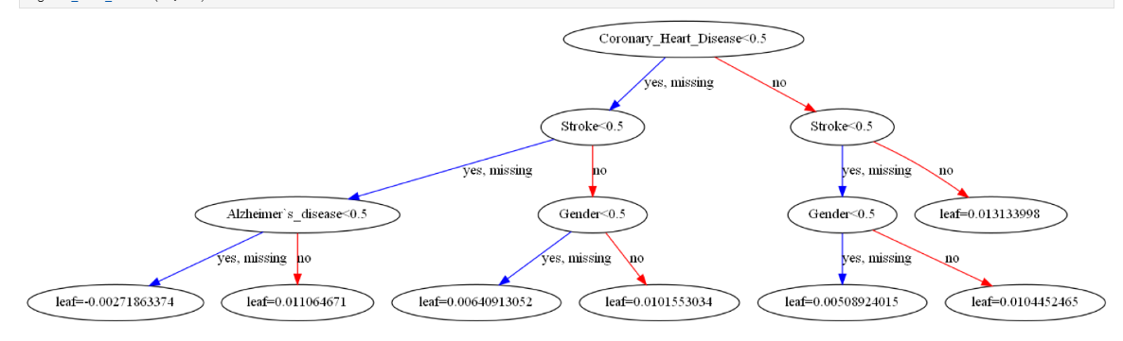
Data-analysis Process 3) Analysis
Analysis Method:
XGBoost Classifier
Decision Tree Classification
Evaluation metric:
Set to prioritize finding all mortalities.

Slide 14
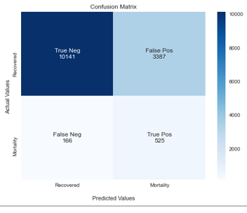
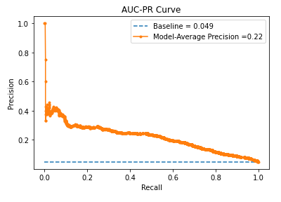
Outline of Findings
The model performed reasonably well
Accuracy: 75%
Precision/Recall Curve

Slide 15
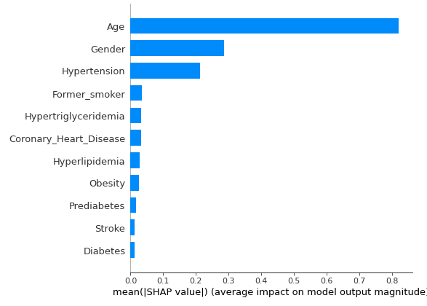
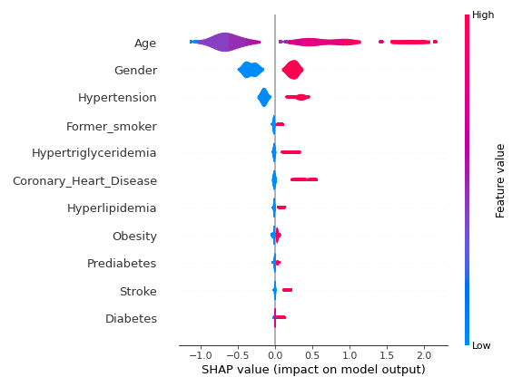
Outline of Findings
Ranked Importance- the top 11 conditions that impacted the predictions.
Contribution by Feature Value- how the specific values of the features contributed to the predictions

Slide 16
Limitations
Synthetic data- Better insights might be found in actual patient data
The model will need to be validated on actual data before results are actionable by stakeholders.

Slide 17
Proposed Actions
Apply the model to an actual patient database to evaluate performance.
Consider including clinical measurements for each patient at the time of diagnosis. A patient who has been sick for days before coming in to be seen may already be too late to benefit from treatment as well as a patient diagnosed at the first sign of sickness (Sun et al. 2020).
Include Covid vaccination status to see if it affects mortality. At the time of this study, Covid vaccinations were not documented in the dataset.

Slide 18
Expected Benefits of the Study
Once validated with actual patient data, the results will offer insight to healthcare organizations to develop protocols for managing patients and resources during Covid surges.
Prevention- Maximize precautions for at-risk populations with education and vaccination.
Early intervention- Early treatment once diagnosed reduces the severity of the infection reducing the need for hospitalization.
Outpatient treatment- Identifying lower-risk patients allows for treatment safely as an outpatient, reducing hospital volume.

Slide 19
Sources
Balser, J., J. Ryu, M. Hood, G. Kaplan, J. Perlin, and B. Siegel. (2021). Care Systems COVID-19 Impact Assessment: Lessons Learned and Compelling Needs. NAM Perspectives. Discussion Paper, National Academy of Medicine, Washington, DC. Care Systems COVID-19 Impact Assessment: Lessons Learned and Compelling Needs - National Academy of Medicine (nam.edu)
French G, Hulse M, Nguyen D, et al. (2021). Impact of Hospital Strain on Excess Deaths During the COVID-19 Pandemic — United States, July 2020–July 2021. MMWR Morb Mortal Wkly Rep, 70, 1613–1616. Impact of Hospital Strain on Excess Deaths During the COVID-19 Pandemic — United States, July 2020–July 2021 | MMWR (cdc.gov)
Hick, J. L., D. Hanfling, M. Wynia, and E. Toner. (2021). Crisis Standards of Care and COVID-19: What Did We Learn? How Do We Ensure Equity? What Should We Do? NAM Perspectives. Discussion, National Academy of Medicine, Washington, DC. Crisis Standards of Care and COVID-19: What Did We Learn? How Do We Ensure Equity? What Should We Do? - National Academy of Medicine (nam.edu)
Sun, Q., Qiu, H., Huang, M., & Yang, Y. (2020). Lower mortality of COVID-19 by early recognition and intervention: experience from Jiangsu Province. Annals of intensive care, 10(1), 33. https://doi.org/10.1186/s13613-020-00650-2
Walonoski, J., Klaus, S., Granger, E., Hall, D., Gregorowicz, A., Neyarapally, G., Watson, A., & Eastman, J. (2020). Synthea™ Novel coronavirus (COVID-19) model and synthetic data set. Intelligence-based medicine, 1, 100007Synthea™ Novel coronavirus (COVID-19) model and synthetic data set - ScienceDirect

